Slide 1
DATA ANALYSIS
Measurement in GIS

Slide 2
What is spatial data?
The nature of the spatial data used has been reviewed, and the encoding and structuring of these data to produce a computer representation of the real world outlined.

Slide 3
What is analysis?
The analysis they undertake with GIS may lead, data to new information that will inform decision making.
For example, end users of a webbased mapping applications may be able to answer simple queries about the location of places of interest, or to identify shortest routes between features using mobile GIS platforms.
As a result they can make decisions about where to go next, and how to get there.

Slide 4
What is spatial analysis?
Methods for working with spatial data
  to detect patterns, anomalies
  to find answers to questions
  to test or confirm theories
    deductive reasoning
  to generate new theories and generalizations
    inductive reasoning
"a set of methods whose results change when the locations of the objects being analyzed change"

Slide 5
What is Spatial Analysis (cont.)
Methods for adding value to data
  in doing scientific research
  in trying to convince others
Turning raw data into useful information
A collaboration between human and machine
  Human directs, makes interpretations and inferences
  Machine does tedious, complex stuff

Slide 6
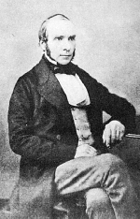


Early Spatial Analysis
John Snow, 1854
Cholera via polluted water, not air
Broad Street Pump

Slide 7
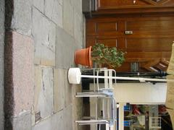
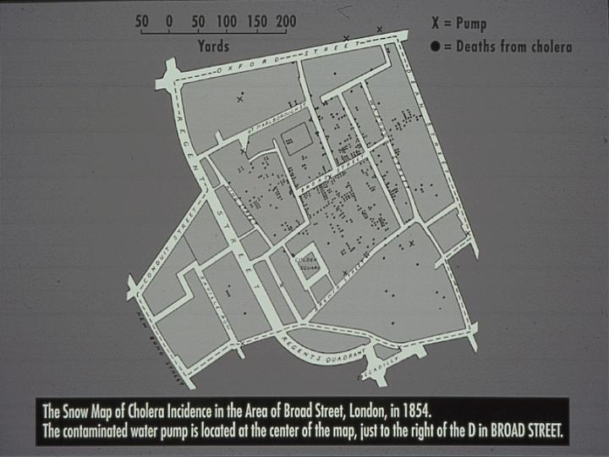
John Snow’s Map

Slide 8

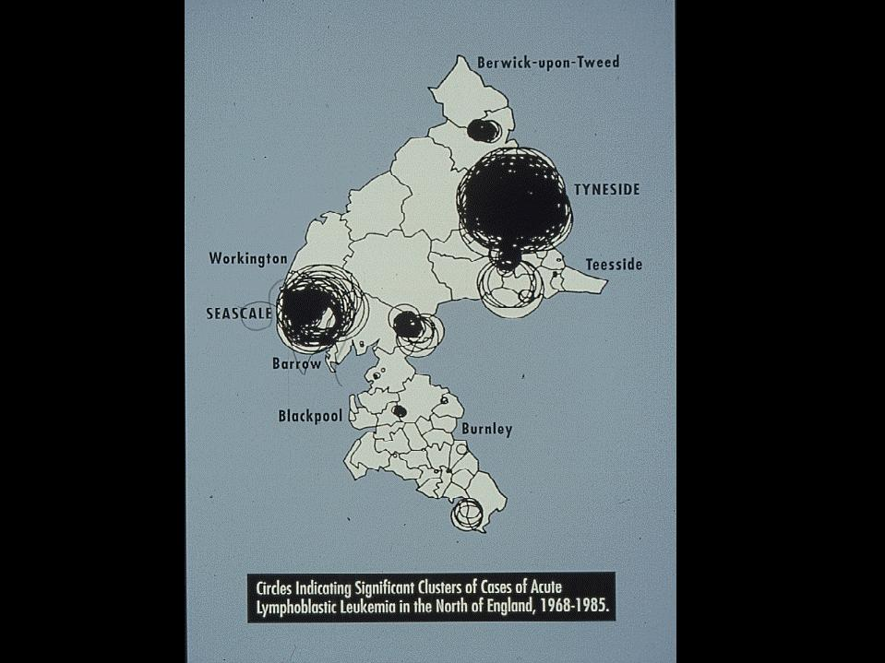
Updating Snow:
Openshaw 1965-’98
Geographic Analysis Machine
Search datasets for event clusters
  cases: pop at risk
Geographical correlates for:
  Cancer
  Floods
  Nuclear attack
  Crime

Slide 9
Objectives of Spatial Analysis
Queries and reasoning
Measurements
  Aspects of geographic data, length, area, etc.
Transformations
  New data, raster to vector, geometric rules
Descriptive summaries
  Essence of data in a few parameters
Optimization - ideal locations, routes
Hypothesis testing – from a sample to entire population

Slide 10
Answering Queries
A GIS can present several distinct views
Each view can be used to answer simple queries
  ArcCatalog
  ArcMap

Slide 11
Functions for data analysis Functions available in most GIS packages, including
Measurement techniques
Attribute queries
Proximity analysis
Overlay operations and
Analysis of models of surfaces and networks.

Slide 12
Data analysis terminology
Entity
Attribute
Feature
Data layer
Image
Cell
Function or operation
Algorithm

Slide 13
Data analysis terminology
Entity: An individual point, line or area in a GIS database
Attribute: Data about an entity.
In a vector GIS attributes are stored in a database. For example, the street name for a line entity that represents a road may be stored.

Slide 14
Data analysis terminology
In a raster GIS the value of a cell in the raster grid is a numerical code used to represent the attribute present.
For example, code ‘1’ may be used for a motorway, ‘2’ for a main road and ‘3’ for a minor road. Further attributes of an entity (for instance street name) may be stored in a database linked to the raster image

Slide 15
Data analysis terminology
Feature: An object in the real world to be encoded in a GIS database
Data layer: A data set for the area of interest in a GIS.
For example, the Happy Valley GIS contains data layers on nine themes, including roads, ski runs, hotels and land use.

Slide 16
Data analysis terminology
Data layers in a GIS normally contain data of only one entity type (that is points, lines or areas).
It would be unusual for a data layer to contain, for instance, roads and hotels; these would be stored as separate thematic data layers

Slide 17
Data analysis terminology
Image: A data layer in a raster GIS. It should be remembered that each cell in a raster image will contain a single value that is a key to the attribute present there
Cell: An individual pixel in a raster image
Function or operation: A data analysis procedure performed by a GIS
Algorithm: The computer implementation of a sequence of actions designed to solve a problem

Slide 18
MEASUREMENTS IN GIS
Calculating measurements
  Lengths,
  Perimeters and
  Areas
Method of measurement employed in GIS.
  Raster and Vector
vector data are made up of straight line segments (even lines which appear as
curves on the screen are stored as a collection of short straight line segments)

Slide 19
MEASUREMENTS IN GIS
Raster method: all raster entities are approximated using a grid cell representation.
Normally the shortest path, or Euclidean distance, is calculated by drawing a straight line between the end points of a line, and
creating a right-angled triangle so that Pythagorean geometry can be used.

Slide 20
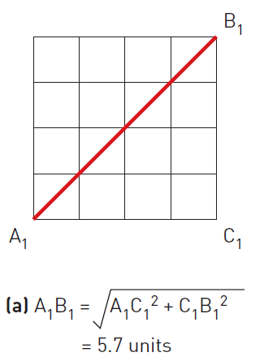
MEASUREMENTS IN GIS
In this case the distance AB is calculated using the formula:
  AB² = AC² + CB²
  AB = sqrt(AC² + CB²)

Slide 21
MEASUREMENTS IN GIS
Alternatively, a ‘Manhattan’ distance can be calculated.
This is the distance along raster cell sides
from one point to the other. The name for this method comes from the way in which you would get across a city, like Manhattan, consisting of dense ‘blocks’ of buildings. As it is impossible to pass diagonally through a block, you have to traverse the sides

Slide 22
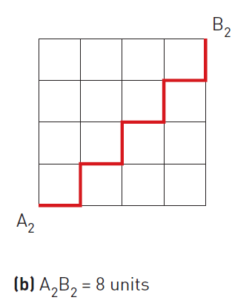
MEASUREMENTS IN GIS
‘Manhattan’ distance

Slide 23
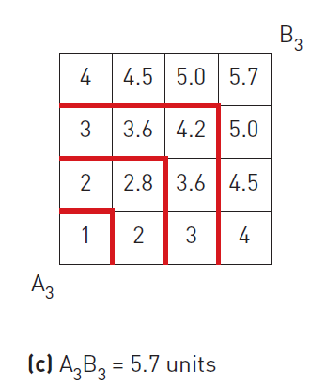
MEASUREMENTS IN GIS
A third method of calculating distance in a raster GIS uses ‘proximity’ (Berry, 1993).
In this method, concentric equidistant zones are established around the start point A.

Slide 24
MEASUREMENTS IN GIS
A third method of calculating distance in a raster GIS uses ‘proximity’ (Berry, 1993).
In this method, concentric equidistant zones are established around the start point A.

Slide 25
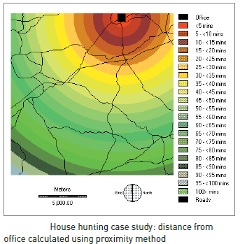
MEASUREMENTS IN GIS
‘Proximity’ method example:

Slide 26
MEASUREMENTS IN GIS
Perimeter calculation: To obtain a perimeter measurement in a raster GIS, the number of cell sides that make up the boundary of a feature is multiplied by the known resolution of the raster grid.
Area calculation: The number of cells a feature occupies is multiplied by the known area of an individual grid cell

Slide 27
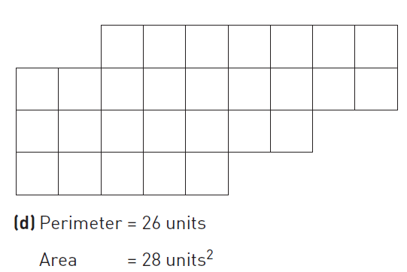
MEASUREMENTS IN GIS
Perimeter and Area calculations

Slide 28
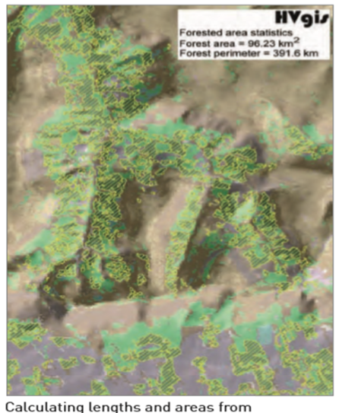
MEASUREMENTS IN GIS
The area of forestry in Happy Valley (from a classified satellite image in a raster GIS) could be obtained in this way

Slide 29
MEASUREMENTS IN GIS
In a vector GIS distances are measured using Pythagoras’s theorem to obtain the Euclidean distance.
Geometry is also used to calculate perimeters and areas.
Perimeters are built up of the sum of straight line lengths, and areas are calculated by totaling the areas of simple geometric shapes formed by subdividing the feature of interest.

Slide 30
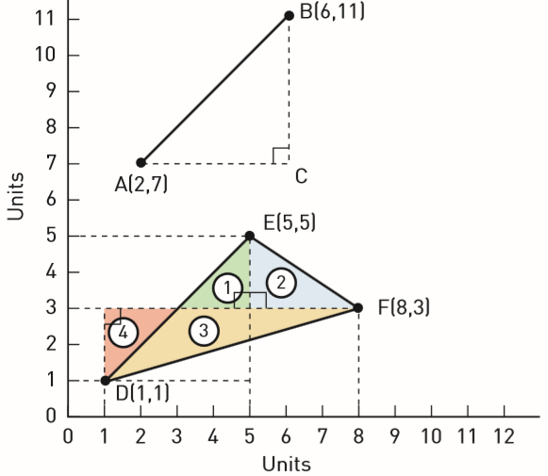
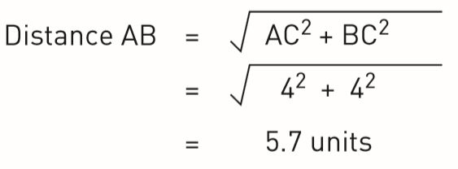
Vector GIS Measurements

Slide 31
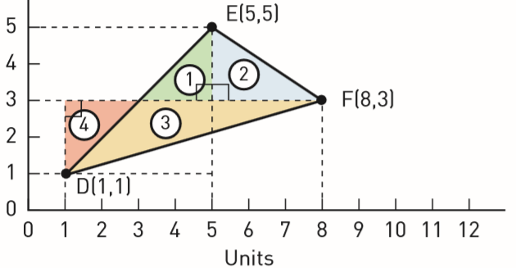
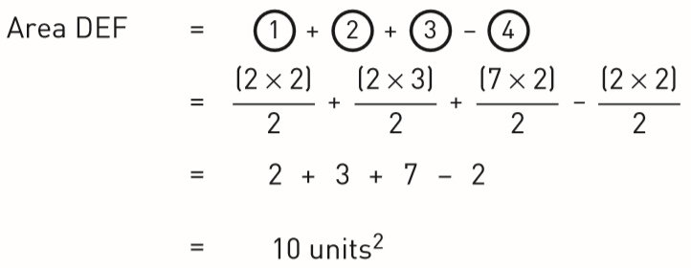
Vector GIS Measurements

Slide 32
MEASUREMENTS IN GIS
In vector GIS, length, perimeter and area data can be stored as attributes in a database, so these need to be calculated only once and then are permanently saved.

Slide 33
QUERIES
Queries offer a method of data retrieval, and can be performed on data that are part of the GIS database, or on new data produced as a result of data analysis.
Queries are useful at all stages of GIS analysis for checking the quality of data and the results obtained.
For example, a query may be used if a data point representing a hotel is found to lie erroneously in the sea after data encoding

Slide 34
QUERIES
A query may establish that the address of the hotel had been wrongly entered into a database, resulting in the allocation of an incorrect spatial reference.
There are two general types of query that can be performed with GIS: spatial and aspatial.

Slide 35
QUERIES
A query may establish that the address of the hotel had been wrongly entered into a database, resulting in the allocation of an incorrect spatial reference.
There are two general types of query that can be performed with GIS: spatial and aspatial.

Slide 36
QUERIES
A query may establish that the address of the hotel had been wrongly entered into a database, resulting in the allocation of an incorrect spatial reference.
There are two general types of query that can be performed with GIS: spatial and aspatial.

Slide 37
QUERIES
Aspatial queries are questions about the attributes of features. ‘How many luxury hotels are there?’ is an aspatial query since neither the question nor the answer involves analysis of the spatial component of data. This query could be performed by database software alone.

Slide 38
QUERIES
Aspatial queries are questions about the attributes of features. ‘How many luxury hotels are there?’ is an aspatial query since neither the question nor the answer involves analysis of the spatial component of data. This query could be performed by database software alone.

Slide 39
QUERIES
A user may point at a hotel on the computer screen and click to obtain the answer to ‘What is the name of this hotel?’.
Queries can be made more complex by combination with questions about distances, areas and perimeters, particularly in a vector GIS, where these data are stored as attributes in a database.

Slide 40
QUERIES
‘Where is the longest ski run?’ to be answered in one step, where a raster GIS might require two:–
one to calculate the lengths of all the ski runs, and the
second to identify the longest.
Individual queries can be combined to identify entities in a database that satisfy two or more spatial and aspatial criteria, for example ‘Where are the luxury hotels which have more than 20 bedrooms?’.

Slide 41
QUERIES
Boolean operators are often used to combine queries of this nature.
These use AND, NOT, OR and XOR, operations that are also used for the combination of different data sets by overlay.

Slide 42
QUERIES
‘Where are the hotels which are in the category “luxury” AND have more than 20 bedrooms?’
It will yield a different answer from the question
‘Where are the hotels which are in the category “luxury” OR have more than 20 bedrooms?’
The second query will probably identify more hotels.

Slide 43
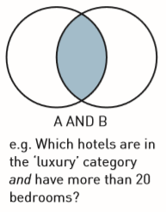
QUERIES
Boolean expressions used in GIS with the help of Venn diagrams.
A is the set of hotels that are in the ‘luxury’ category
B is the set of hotels that have more than 20 bedrooms.

Slide 44
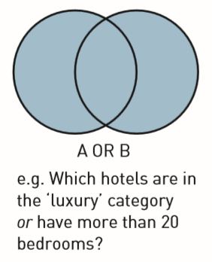
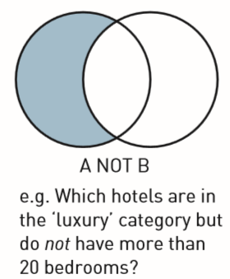
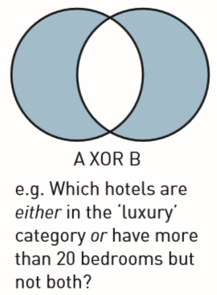
QUERIES

Slide 45
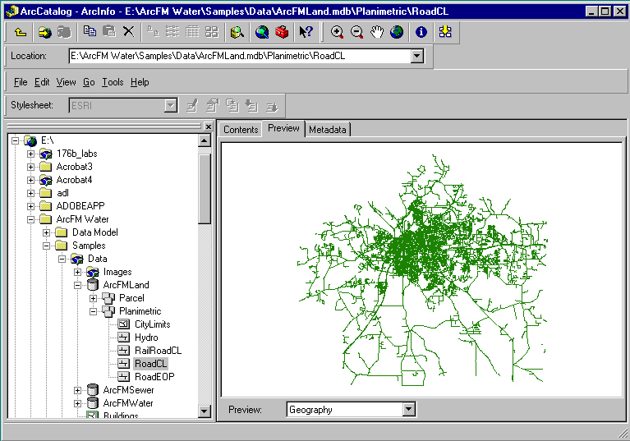
Views to Help w/Queries
hierarchy of devices, folders, datasets, files
Map, table, metadata

Slide 46
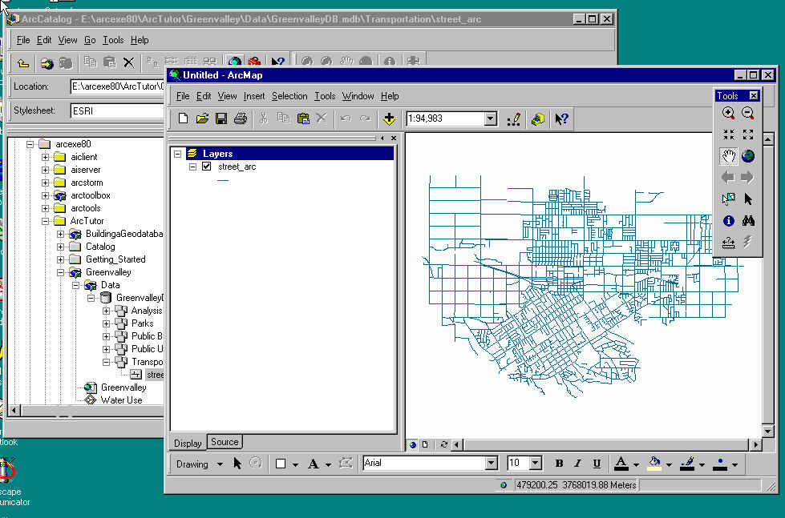
Views to Help w/Queries
ArcMap - map view

Slide 47
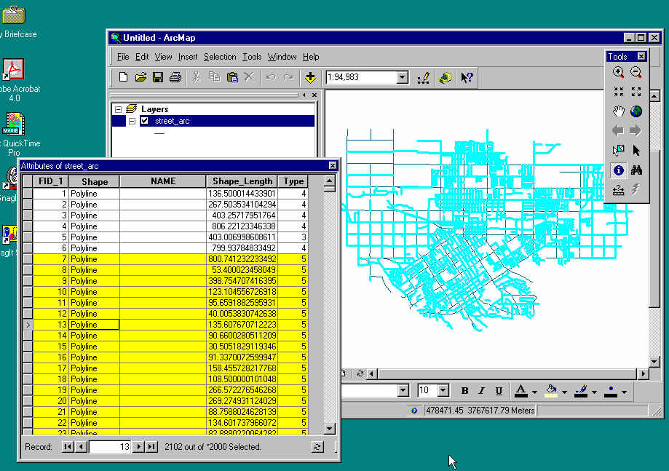
Views to Help w/Queries
ArcMap - table view linked to map

Slide 48
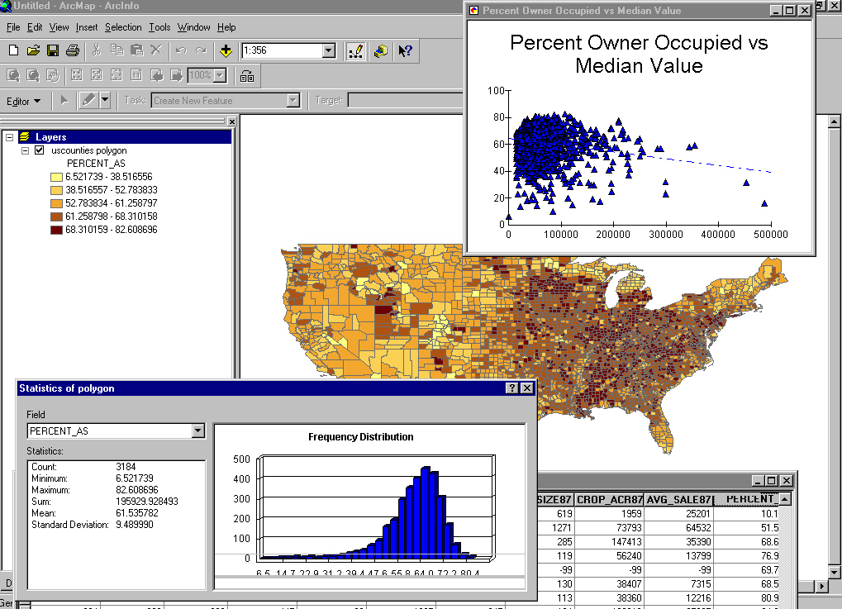
Views to Help w/Queries
ArcMap - histogram and scatterplot views

Slide 49
Exploratory Data Analysis ( EDA )
Interactive methods to explore spatial data
Use of linked views
Finding anomalies, outliers
In images, finding particular features
Data mining large masses of data
  e.g., credit card companies
  anomalous behavior in space and time

Slide 50
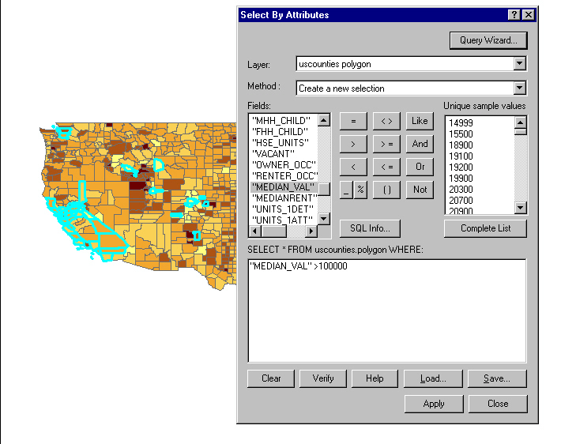
SQL in EDA
Structured or Standard query language
SELECT FROM counties WHERE median value > 100,000
Result is HIGHLIGHTed

Slide 51
Spatial Reasoning with GIS
GIS would be easier to use if it could "think" and "talk" more like humans
  or if there could be smooth transitions between our vague world and its precise world
  Google Maps

